Slide 1

Random quotes generator
This Photo by Unknown Author is licensed under CC BY-NC-ND
A React-based web application that generates random quotes to inspire and motivate users.
The app allows users to share quotes on social media and customize the design and layout of the quote display.

Slide 2

Team members
Anjali Jain (201500094)
Naina Johri ( 201500422 )

Slide 3

Technology used:-
mongodb
Express js
REACT
NODE JS

Slide 4
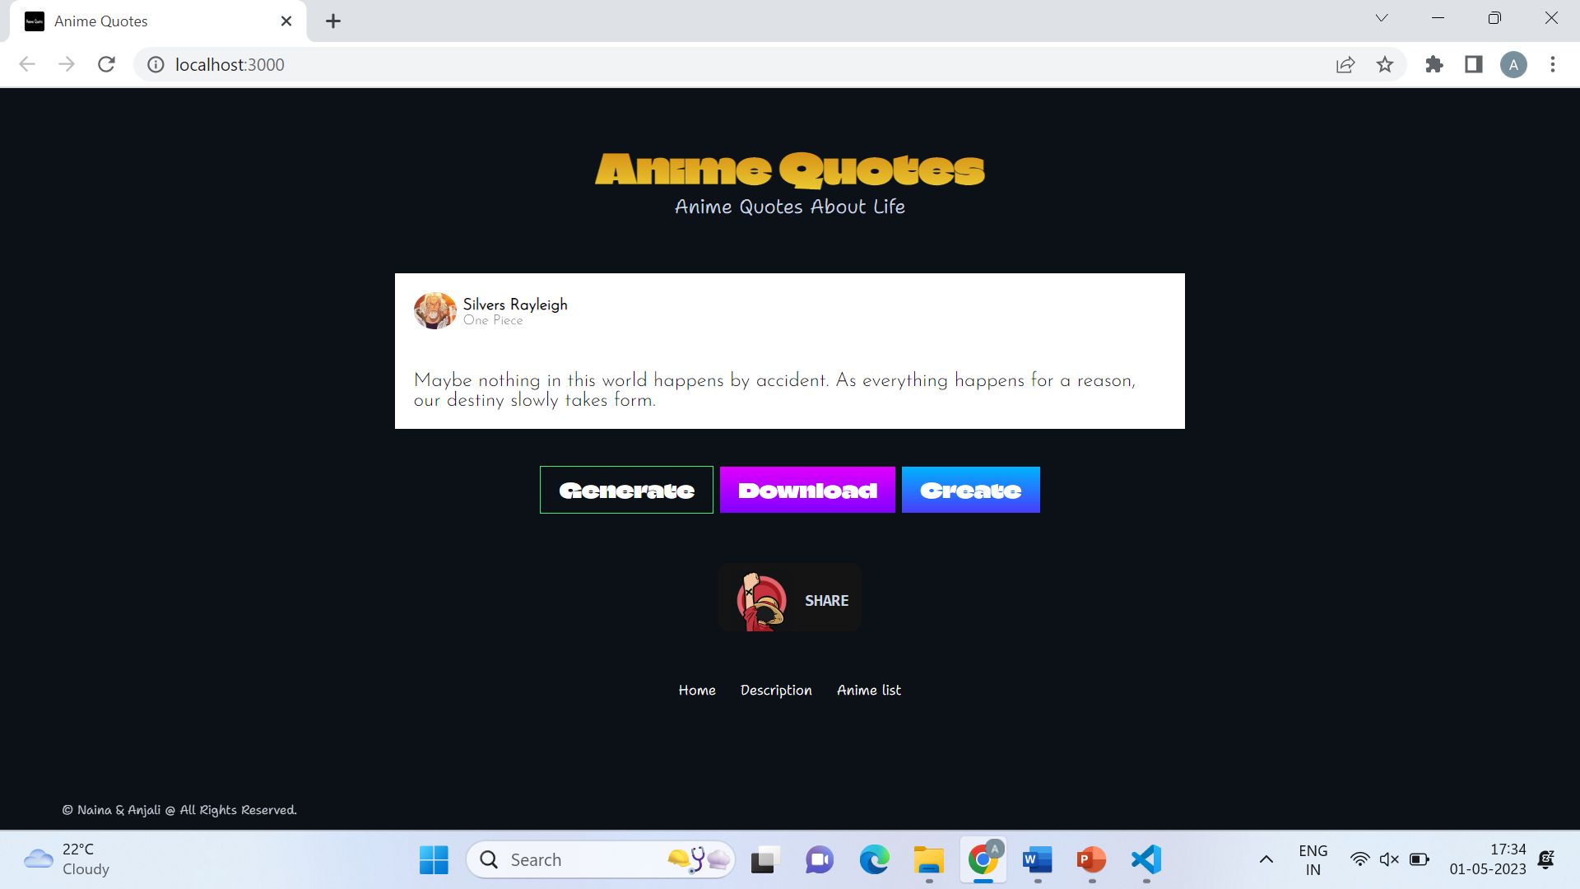
Navigation Bar:-

Slide 5
The page includes a navigation bar with links to various sections of the website
Like:
Home
Anime list
Description
a large and eye-catching quote that is randomly generated, information about the author, buttons to share the quote on social media, a search bar to search for quotes, and a list of popular categories.
The use of React ensures a seamless and responsive user experience with fast loading times and smooth transitions between different sections of the website.

Slide 6
HOME page:-
The homepage of this random quotes generator using React is designed to provide a simple and intuitive user interface that allows users to quickly generate and explore a wide variety of inspiring and thought-provoking quotes.
At the top of the page, users will find a clean and modern navigation bar that includes the logo of the website and links to various sections of the website, such as "Generate", “Download",and “create".

Slide 8
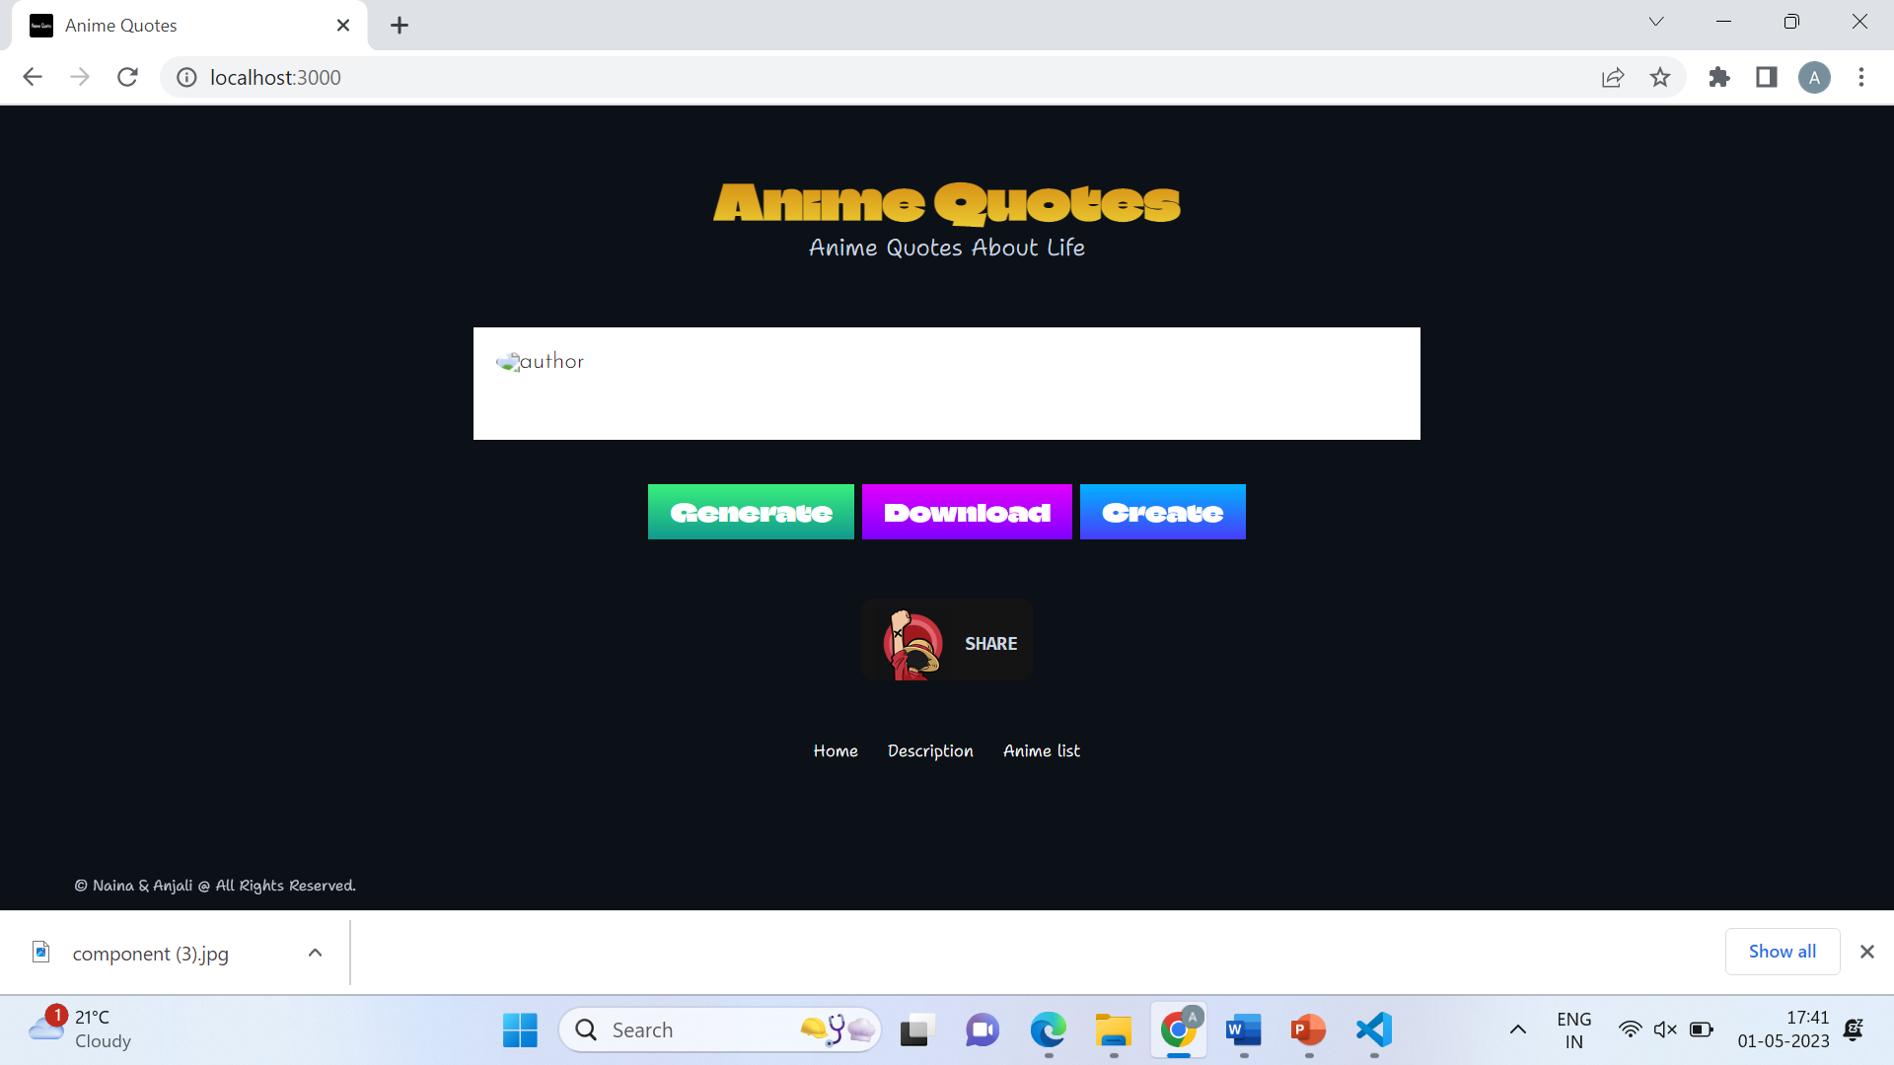

Slide 9
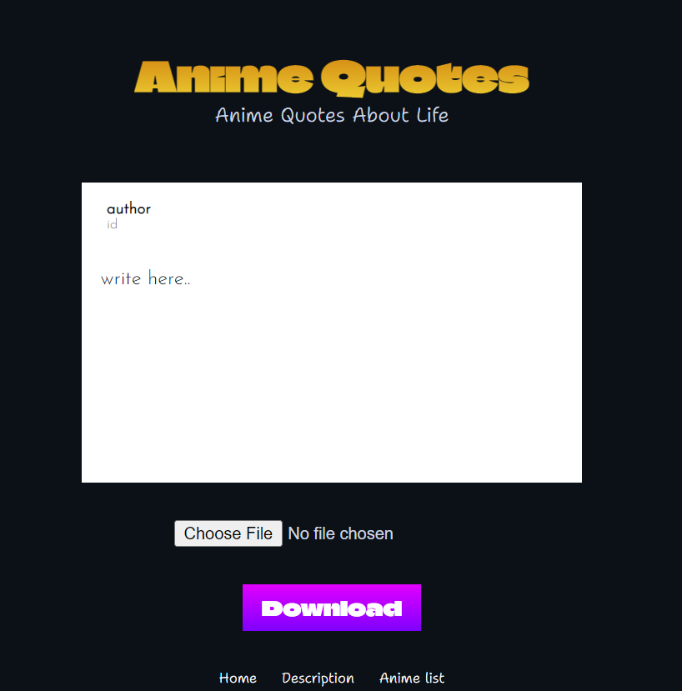

Slide 10
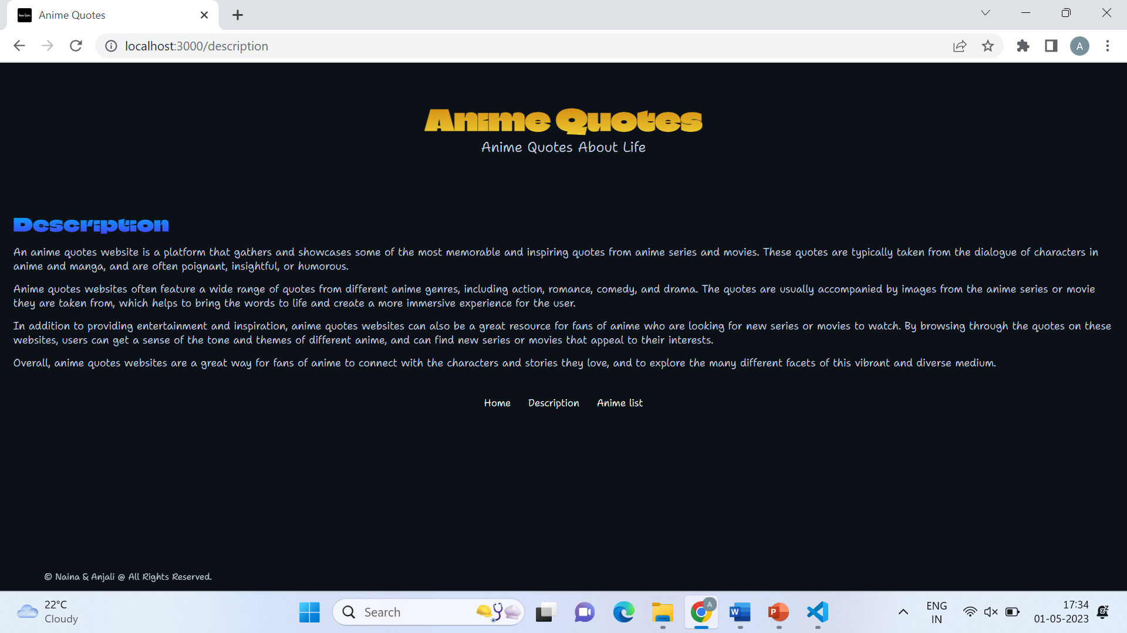

Slide 11
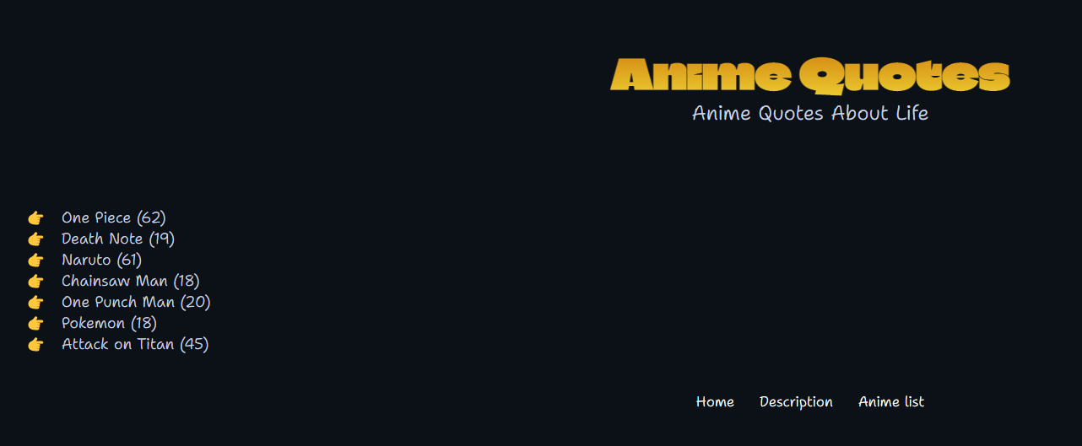

Slide 12

REFERENCES:
We are waiting for your valuable feedback.

